Slide 1
Modern C++
DATE: 18th Mar 2017

Slide 2
C++ - What is it?
C++:
Is a systems and applications programming language.
Supports multi-paradigms/styles of programming – OO/Generic/others.
Facilitates high level abstractions.
Supports a stronger type system.
Is at the very least, it is a better C
Runs as fast as C while handling complexity.

Slide 3
C++ - Where is it used?
C++ is used:
When performance and resource efficiency counts.
To empowers infrastructure and operating systems.
In embedded Systems where resources are very limited.
In mobile Systems were power is very limited.
In High end cloud systems where power wastage should be minimum.
In large scale super computing systems (like weather simulation).
Is used in Game Development.
Is used in Financial Industry.
In NASA’s Curiosity Rover on Mars!

Slide 4
C++ - Past
Initially:
C++ was a huge success and its users grew to millions (and still increasing).
Later:
The growth of C++ was slowed down with the introduction of “managed” proprietary languages (like Java, and later C#) as simpler alternatives that traded “developer productivity” for “runtime performance”.
Moore’s Law meant slow performance was easily offset by faster processors.
Huge investments of big organizations for their proprietary language ensured that there was a huge library SDKs for developers.

Slide 5
C++ - Resurgence
C++ Strengths:
C++ is an ISO standard, and not controlled by any proprietary organization.
C++ has a powerful set of “generic algorithms and containers” library designed by Alex Stepanov, which is part of the standard.
C++ templates allow high expressiveness (for library users) without trading off performance. Templates powers “generic programming”, “meta programming”, “expression templates”.
The Boost C++ Library was created with the intention to supplement the standard library with common facilities and utilities. It became hugely popular because of it its superior quality implementation. Boost became an incubation center for future C++ libraries and standards.

Slide 6
C++ - Resurgence
Changing Ecosystem:
Saturation of the moore’s law curve meant: no more “free lunch”.
Multi-core processors meant that its not possible to continue to write software in traditional ways.
Industry demand for maximal efficiency on “Mobile Enabled Systems”.
Industry demand for maximal efficiency on “Cloud systems”.
Higher complexity requirements of managed software made it slow in system programming contexts.

Slide 7
C++ - Resurgence
Standardization:
C++11 standard was timed to ensure that the language kept with changing times to stay relevant.
Industry Backing:
Renewed interest from big corporations:
Microsoft, Google, Adobe, Facebook.
Compiler Vendors
Microsoft Visual Studio, GCC, Clang, etc. (Some are already C++17 compliant)
Tooling Support
clang, clion (jetbrains)
Libraries:
Facebook – Foly, Amazon C++ SDK, Google’s Android C++ SDK, Microsoft C++ SDK.

Slide 8
C++ - Timeline
Timeline:
1979 – C++ was created in 1979 by Bjarne Stroustroup.
1998 – ISO Standardization – (had STL, std::algorithms – from Alex)
2003 – ISO Standard – very minor changes.
2011 – ISO Standard – large changes.
2014 – ISO Standard – very minor changes.
2017 – Upcoming ISO Standard – due this year.
2020 – Future ISO Standard.

Slide 9
C++ - New Features - Language
C++11:
auto type deduction, lambdas, range-for, rvalue references, decltype, uniform initialization, template alias, unrestricted unions, enum class, explicit conversion operators, constexpr, static_assert, variadic templates, multithreading memory model, thread_local, defaulted and deleted functions, attributes, user defined literals, override, final, initializer_list
C++14:
Return type deduction, relaxed constexpr, polymorphic lambdas, variable templates
C++17:
type deduction in constructors, auto in template, if-constexpr, variadic fold expressions, auto structured bindings

Slide 10
C++ - New Features - Library
C++11:
thread, atomic, mutex, condition_variable, futures, async, chrono, smart pointers, tuple, unordered_map/set, array, regex, polymorphic function object wrapper, traits for meta programming, exception_ptr
C++14:
heterogeneous lookup for maps, standard library string literals.
C++17:
string_view, optional, any, variant, filesystem library, parallel algorithms
C++20/TS:
concepts, ranges, parallelism (exec policy: par, seq, vec), concurrency (futures, atomics), transactional memory, coroutines, modules, reflection, …

Slide 11
Modern C++ - handling resources
void copy_file(const char* srcfname, const char* des_fname) {
// open src and copy to des
}
int main() {
copy_file( “in.txt”, “out.txt” );
}

Slide 12
Modern C++ - handling resources
void copy_file(const char* iname, const char* oname) { // v1
FILE* in = fopen(iname, “r”);
FILE* out = fopen(oname, “w”);
char buffer[1024];
while (true) {
std::size_t bytes = fread(buffer, 1, sizeof(buffer), in);
if(bytes > 0)
fwrite(buffer, 1, bytes, out);
if(bytes != sizeof(buffer))
break;
}
}

Slide 13
Modern C++ - handling resources
void copy_file(const char* iname, const char* oname) { // v2
FILE* in = fopen(iname, “r”);
FILE* out = fopen(oname, “w”);
char buffer[1024];
while (true) {
std::size_t bytes = fread(buffer, 1, sizeof(buffer), in);
if(bytes > 0)
fwrite(buffer, 1, bytes, out);
if(bytes != sizeof(buffer))
break;
}
fclose(out);
fclose(in);
}

Slide 14
Modern C++ - handling resources
bool copy_file(const char* iname, const char* oname) { // v3
FILE* in = fopen(iname, “r”); if(in == NULL) return false;
FILE* out = fopen(oname, “w”); if(out == NULL) return false;
char buffer[1024];
while (true) {
std::size_t bytes = fread(buffer, 1, sizeof(buffer), in);
if(ferror(in) != 0) return false;
if(bytes > 0) {
fwrite(buffer, 1, bytes, out);
if(ferror(out) != 0) return false;
}
if(bytes != sizeof(buffer))
break;
}
fclose(out);
fclose(in);
return true;
}
int main() {
if( ! copy_file( “in.txt”, “out.txt” ) )
exit(1);
}

Slide 15
Modern C++ - handling resources
bool copy_file(const char* iname, const char* oname) { // v4
MyFile in(iname, “r”);
MyFile out(oname, “w”);
while( std::string buffer = in.read(buffer, 1024); !buffer.empty() )
out.write(buffer);
}
class MyFile {
// wraps a FILE*
};
int main() {
copy_file( “in.txt”, “out.txt” );
}

Slide 16
Modern C++ - handling resources
class MyFile { // v4
MyFile(const char* f, const char* mode);
~MyFile();
std::string read(std::size_t);
void write(const std::string&);
private:
FILE* m_file;
};

Slide 17
Modern C++ - handling resources
class MyFile { // v4
MyFile(const char* f, const char* mode) {
m_file = fopen(iname, mode);
if(m_file == nullptr) throw io_error{“open”};
}
~MyFile() {
fclose(m_file);
}
std::string read(std::size_t);
void write(const std::string&);
private:
FILE* m_file;
};

Slide 18
Modern C++ - handling resources
class MyFile { // v4
MyFile(const char* f, const char* mode) {
m_file = fopen(iname, mode);
if(m_file == nullptr) throw io_error{“open”};
}
~MyFile() {
fclose(m_file);
}
MyFile(const MyFile&) = delete;
void operator=(const MyFile&) = delete;
std::string read(std::size_t);
void write(const std::string&);
private:
FILE* m_file;
};

Slide 19
Modern C++ - handling resources
class MyFile { // v4
…
bool read(std::string& s) {
char buffer[1024];
size_t bytes = fread(buffer, 1, sizeof(buffer), m_file);
if(ferror(in) != 0) throw io_error{“read”};
if(bytes > 0) s.assign(buffer, bytes);
return bytes > 0;
}
…
private:
FILE* m_file;
};

Slide 20
Modern C++ - handling resources
class MyFile { // v4
…
bool read(std::string& s) {
char buffer[1024];
size_t bytes = fread(buffer, 1, sizeof(buffer), m_file);
if(ferror(in) != 0) throw io_error{“read”};
if(bytes > 0) s.append(buffer, bytes);
return bytes > 0;
}
…
private:
FILE* m_file;
};

Slide 21
Modern C++ - handling resources
class MyFile { // v4
…
std::string read(size_t bytes) {
std::string ret;
while( bytes ) read(ret, bytes);
return ret;
}
…
private:
void read(std::string& s, std::size_t& sz) {
char buffer[1024];
std::size_t bytes = fread(buffer, 1, std::min(sizeof(buffer), sz), m_file);
if(ferror(in) != 0) throw io_error{“read”};
if(bytes > 0) { s.append(buffer, bytes); sz -= bytes; }
}
FILE* m_file;
};

Slide 22
Modern C++ - handling resources
void copy_file(const char* iname, const char* oname) { // v5
std::ifstream in{ iname, std::ios::binary };
std::ofstream out{ oname, std::ios::binary };
std::istreambuf_iterator<char> in_begin{in};
std::istreambuf_iterator<char> in_end { };
std::ostreambuf_iterator<char> out_begin{in};
std::copy(in_begin, in_end, out_begin);
}
int main() {
copy_file( “in.txt”, “out.txt” );
}

Slide 23
Modern C++ - handling resources
void copy_file(const char* iname, const char* oname) { // v6
std::ifstream in{ iname, std::ios::binary };
std::ofstream out{ oname, std::ios::binary };
out << in.rdbuf();
}
int main() {
copy_file( “in.txt”, “out.txt” );
}

Slide 24
Modern C++ - handling resources
#include <filesystem> // v7
int main() {
std::copy_file( “in.txt”, “out.txt” );
}

Slide 25
Always wrap resources into an RAII class.
You will never leak memory or resources ever (even in the presence of exceptions).
Your code is clutter free and expresses only program logic (not cluttered with error handling).

Slide 26
Modern C++ - strong type system
class Parser {
// parse file contents
// parse data contents
};

Slide 27
Modern C++ - strong type system
class Parser { // v1
void ParseFile(std::string filename) { … }
void ParseData(std::string data) { … }
};

Slide 28
Modern C++ - strong type system
class Parser { // v2
void Parse(File filename) { … }
void Parse(Data data) { … }
};

Slide 29
Modern C++ - strong type system
class Point2D { // v1
static Point2D FromCart(float x, float y) { … }
static Point2D FromPolar(float r, float deg) { … }
};

Slide 30
Modern C++ - strong type system
class Point2D { // v2
Point2D(quantity<length> x, quantity<length> y) { … }
Point2D(quantity<length> r, quantity<angle> deg) { … }
};
quantity<length> operator “”_km (float f) { … }
quantity<length> operator “”_m (float f) { … }
quantity<angle> operator “”_deg(float f) { … }
quantity<angle> operator “”_rad(float f) { … }
Point2D p1{ 2_km, 3_m };
Point2D p2{ 2_m, 4_deg };

Slide 31
Make your types expressive, and catch errors early, at compile time.
Catch bugs even before you compile! Use your compiler as your test case!
Bugs need not slip through to runtime or into your deployments.

Slide 32
Modern C++ - nullable invariant
struct DataHandler { // v1
std::string data;
};
struct DataHandler {
void Receive() { … ; data = … ; };
void Process() { if(!data.empty()) foo(data); }
}

Slide 33
Modern C++ - nullable invariant
struct DataHandler { // v2
std::string data;
bool data_present;
};
struct DataHandler {
void Receive() { data_present = false; … ; data = … ; data_present = true; … };
void Process() { if(!data_present) foo(data); }
}

Slide 34
Modern C++ - nullable invariant
struct DataHandler { // v3
std::optional<std::string> data;
};
struct DataHandler {
void Receive() { … ; data = … ; };
void Process() { if(data) foo(*data); }
}

Slide 35
Express nullable invariants directly and simply.
Your class’s nullable invariant will never go out of sync.

Slide 36
Modern C++ - complex class invariants
enum class ConnectionState { // v1
DISCONNECTED, CONNECTING, CONNECTED, CONN_INTERRUPTED
};
struct Connection {
void Process() { … }
};

Slide 37
Modern C++ - complex class invariants
enum class ConnectionState { // v1
DISCONNECTED, CONNECTING, CONNECTED, CONN_INTERRUPTED
};
struct Connection { // v1
ConnectionState m_connectionState;
std::string m_serverAddress;
void Process() { … }
};

Slide 38
Modern C++ - complex class invariants
enum class ConnectionState { // v1
DISCONNECTED, CONNECTING, CONNECTED, CONN_INTERRUPTED
};
struct Connection { // v1
ConnectionState m_connectionState;
std::string m_serverAddress;
std::time_t m_connectionStart;
void Process() { … }
};

Slide 39
Modern C++ - complex class invariants
enum class ConnectionState { // v1
DISCONNECTED, CONNECTING, CONNECTED, CONN_INTERRUPTED
};
struct Connection { // v1
ConnectionState m_connectionState;
std::string m_serverAddress;
std::time_t m_connectionStart;
ConnectionId m_id;
std::time_t m_connectedTime;
std::time_t m_lastPingTime = -1;
void Process() { … }
};

Slide 40
Modern C++ - complex class invariants
enum class ConnectionState { // v1
DISCONNECTED, CONNECTING, CONNECTED, CONN_INTERRUPTED
};
struct Connection { // v1
ConnectionState m_connectionState;
std::string m_serverAddress;
std::time_t m_connectionStart;
ConnectionId m_id;
std::time_t m_connectedTime;
std::time_t m_lastPingTime = -1;
Timer m_reconnectTimer;
void Process() { … }
};

Slide 41
Modern C++ - complex class invariants
enum class ConnectionState { // v1
DISCONNECTED, CONNECTING, CONNECTED, CONN_INTERRUPTED
};
void Connection::Process() { // v1
switch(m_connectionState) {
case DISCONNECTED: …; break;
case CONNECTING: …; break;
…
default: …; break;
}
}

Slide 42
Modern C++ - complex class invariants
struct ConnectionBase { // v2
void Process() { this->DoProcess(); }
protected:
virtual void DoProcess() { … };
std::string m_serverAddress;
};

Slide 43
Modern C++ - complex class invariants
struct ConnectionBase { // v2
void Process() { this->DoProcess(); }
protected:
virtual void DoProcess() { … };
std::string m_serverAddress;
};
void Process(ConnectionBase* p) { // v2
p->Process();
}

Slide 44
Modern C++ - complex class invariants
struct Disconnected : ConnectionBase { void DoProcess() {…} };
struct Connecting : ConnectionBase { void DoProcess() {…} };
struct Connected : ConnectionBase {
ConnectionId m_id;
std::time_t m_connectedTime;
std::optional<std::time_t> m_lastPingTime;
void DoProcess() { … }
};
struct ConnInterrupted : ConnectionBase {
std::time_t m_connectionStart;
std::time m_disconnectedTime;
Timer m_reconnectTimer;
void DoProcess() { … }
};
struct ConnectionBase { // v2
void Process() { this->DoProcess(); }
protected:
virtual void DoProcess() { … };
std::string m_serverAddress;
};
void Process(ConnectionBase* p) { // v2
p->Process();
}

Slide 45
Modern C++ - complex class invariants
struct Disconnected { void operator()() { … } };
struct Connecting { void operator()() { … } };
struct Connected {
ConnectionId m_id;
std::time_t m_connectedTime;
std::optional<std::time_t> m_lastPingTime;
void operator()() { … }
};
struct ConnInterrupted {
std::time m_disconnectedTime;
Timer m_reconnectTimer;
void operator()() { … }
};
struct Connection { // v3
std::variant<Disconnected,
Connecting,
Connected,
ConnInterrupted> m_connection;
void Process() { … }
};
void Connection::Process { // v3
std::visit(
[](auto& state) { state(); },
m_connection
);
};

Slide 46
Make illegal states inexpressible, and catch errors early, at compile time.
Why allow expressing states that are impossible, and write test cases to check invariants?
Most bugs are caused because of wrong manipulation of internal states.

Slide 47
Modern C++ - behavioral constraints
std::string GetFormData();
void ExecuteQuery(const std::string& sanitized);

Slide 48
Modern C++ - behavioral constraints
// v1
std::string GetFormData();
void ExecuteQuery(const std::string& sanitized);
// IMP: please call this function before calling ExecuteQuery.
std::string SanitizeFormData(const std::string& unsanitized);

Slide 49
Modern C++ - behavioral constraints
// v2
template<class Phony>
struct FormData {
explicit FormData(const string& str) : m_str(str) {}
std::string m_str;
};
struct sanitized {};
struct unsanitized {};
s

Slide 50
Modern C++ - behavioral constraints
// v2
FormData<unsanitized> GetFormData();
void ExecuteQuery(const FormData<sanitized>&);
std::optional<FormData<sanitized>> SanitizeFormData(const FormData<unsanitized>&);
s

Slide 51
Make illegal behavior fail at compile time, using types (or phony template types).
Now an injection bug is reduced to a harmless compiler error!

Slide 52
Modern C++ - expressing processing logic
struct Node {
int data;
Node* next = nullptr;
};

Slide 53
Modern C++ - expressing processing logic
struct Node {
int data;
Node* next = nullptr;
};
Node* foo(Node*& root) { // v1
Node* root_r = nullptr;
while( Node* x = root ) {
root = x→next;
x->next = root_r;
root_r = x;
}
return root_r;
}

Slide 54
Modern C++ - expressing processing logic
struct Node {
int data;
Node* next = nullptr;
};
Node* foo(Node*& root) { // v2
Node* new_root = nullptr;
while( Node* x = pop_front(root) ) {
push_front( new_root, x );
}
return new_root;
}

Slide 55
Modern C++ - expressing processing logic
struct Node {
int data;
Node* next = nullptr;
};
Node* foo(Node*& root) { // v2
Node* new_root = nullptr;
while( Node* x = pop_front(root) ) {
push_front( new_root, x );
}
return new_root;
}
Node* pop_front(Node*& root) {
Node* x = root;
if(x) { root = x->next; x->next = nullptr; };
return x;
}
void push_front(Node*& root, Node* x) {
if(x) { x->next = root; root = x; };
}

Slide 56
Make your code algorithmic. Compose it using other algorithms, standard algorithms.
You will notice easier readability and maintainability, easier to reason about. Often the resulting code can be faster, or easily substituted by a faster alternative.

Slide 57
Modern C++ - range views
template<typename Iter>
void foo(Iter b, Iter e) { … }
std::vector<int> vi{1,2,3,4,5,6,7,8,9,10};
// remove all odd numbers
// and convert to strings

Slide 58
Modern C++ - range views
template<typename Iter>
void foo(Iter b, Iter e) { … }
std::vector<int> vi{1,2,3,4,5,6,7,8,9,10};
// remove all odd numbers
// and convert to strings
// v1
std::vector<int> vi{1,2,3,4,5,6,7,8,9,10};
std::vector<std::string> vs;
for( auto&& i : vi ) {
if( i % 2 == 0 ) {
vs.push_back( std::to_string( i ) );
}
}
foo( vs.begin(), vs.end() );

Slide 59
Modern C++ - range views
template<typename Iter>
void foo(Iter b, Iter e) { … }
std::vector<int> vi{1,2,3,4,5,6,7,8,9,10};
// remove all odd numbers
// and convert to strings
// v2
std::vector<int> vi{1,2,3,4,5,6,7,8,9,10};
auto x = std::remove_if( vi.begin(), vi.end(),
[](auto i) {
return i % 2 == 1;
}
);
std::vector<std::string> vs;
std::transform( vi.begin(), x, std::back_inserter(vs),
[](auto i) {
return std::to_string(i);
}
);
foo( vs.begin(), vs.end() );

Slide 60
Modern C++ - range views
template<typename Iter>
void foo(Iter b, Iter e) { … }
std::vector<int> vi{1,2,3,4,5,6,7,8,9,10};
// remove all odd numbers
// and convert to strings
// v3
std::vector<int> vi{1,2,3,4,5,6,7,8,9,10};
auto res = vi | view::remove_if( [](auto i) { return i % 2 == 1; } )
| view::transform( [](auto i) {return std::to_string(i); } );
foo( std::begin(res), std::end(res) );

Slide 61
Modern C++ - range actions
template<typename Iter>
void foo(Iter b, Iter e) { … }
std::vector<int> vi{10,2,3,2,1,4,5,10};
// sort and de-dup
// v3
std::vector<int> vi{10,2,3,2,1,4,5,10};
vi |= action::sort | action::unique;
foo( std::begin(vi), std::end(vi) );

Slide 62
Modern C++ - range actions
template<typename Iter>
void foo(Iter b, Iter e) { … }
std::vector<int> vi{10,2,3,2,1,4,5,10};
// sort and de-dup
// v3
std::vector<int> vi{10,2,3,2,1,4,5,10};
vi |= action::sort | action::unique;
foo( std::begin(vi), std::end(vi) );

Slide 63
Use Range v3 algorithms! It provides light weight, composable views and actions on sequences.
Composability allows combining views and actions to create more complex ones.
Remove most while loops, and if conditions, or “imperative” state manipulation, easily readable.
Lazy evaluation of range views means, its very cheap to create and copy.

Slide 64
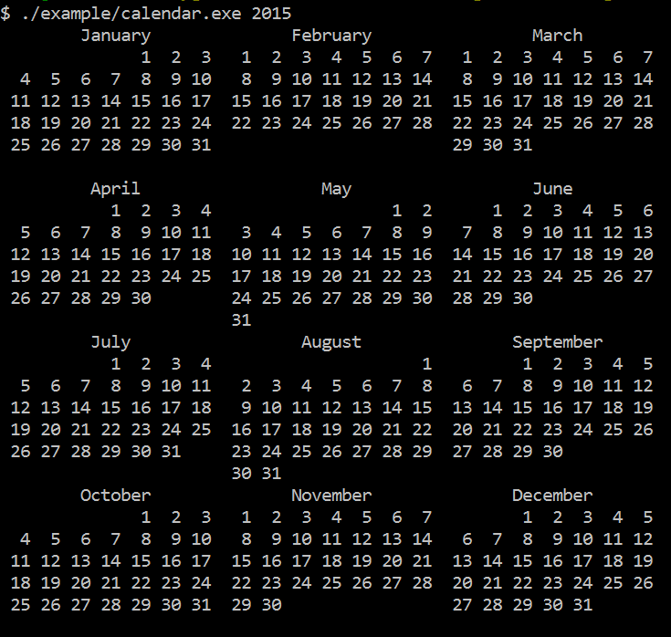
Modern C++ - writing a calendar program

Slide 65
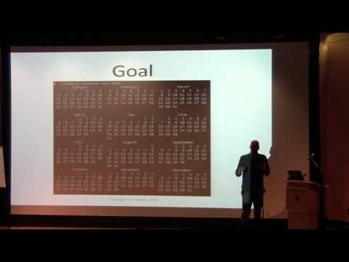
Modern C++ - writing a calendar program

Slide 66
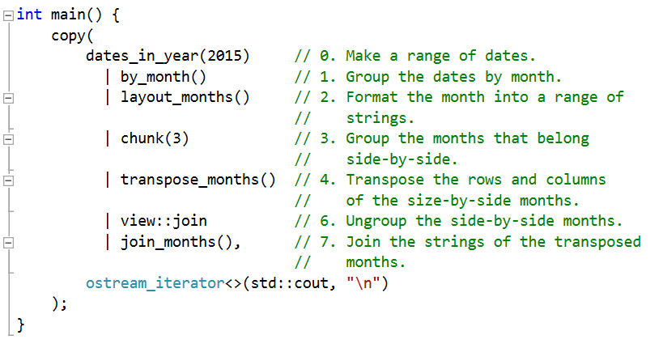
Modern C++ - writing a calendar program

Slide 67
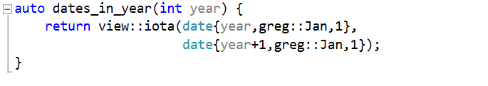
Modern C++ - writing a calendar program

Slide 68
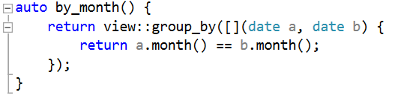
Modern C++ - writing a calendar program

Slide 69
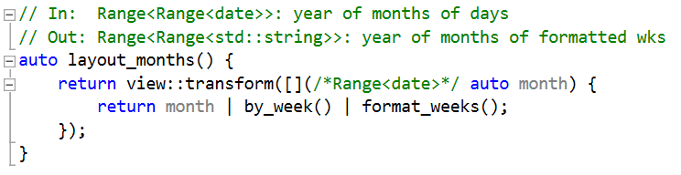
Modern C++ - writing a calendar program

Slide 70
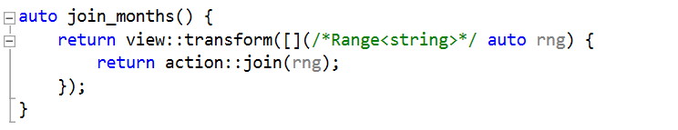
Modern C++ - writing a calendar program

Slide 71
Make your code “declarative” and instead of “imperative”.
You code will be declarative, composable, and correct by design.
You will not need to use if conditions, while loops, in your code.

Slide 72
Use “total functions” which is always defined for all its inputs.
Remove ambiguity and surprising code

Slide 73
Avoid creating incidental data structures in your code.
You will be able to look at the real data structures you use, and reason about their performance.

Slide 74
References
https://www.youtube.com/watch?v=mFUXNMfaciE
https://ericniebler.github.io/range-v3/
https://www.youtube.com/watch?v=ojZbFIQSdl8
https://github.com/CppCon/CppCon2016
https://github.com/CppCon/CppCon2015
https://github.com/CppCon/CppCon2014

